Slide 1
Chapter 3: Authentication, Authorization, and Accounting
CCNA Security v2.0

Slide 2
Chapter Outline
3.0 Introduction
3.1 Purpose of the AAA
3.2 Local AAA Authentication
3.3 Server-Based AAA
3.4 Server-Based AAA Authentication
3.5 Server-Based Authorization and Accounting
3.6 Summary

Slide 3
Section 3.1: Purpose of the AAA
Upon completion of this section, you should be able to:
Explain why AAA is critical to network security.
Describe the characteristics of AAA.

Slide 4
Topic 3.1.1: AAA Overview

Slide 5
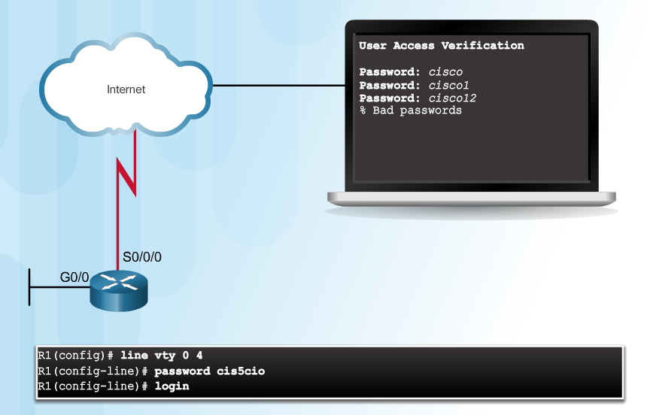
Authentication without AAA
The simplest method of remote access authentication is to configure a login and password combination on console, vty lines, and aux ports, as shown in Figure 1. This method is the easiest to implement, but it is also the weakest and least secure. This method provides no accountability. Anyone with the password can gain entry to the device and alter the configuration.
Telnet is Vulnerable to Brute-Force Attacks
Notes:
3.1.1.1 Authentication without AAA

Slide 6
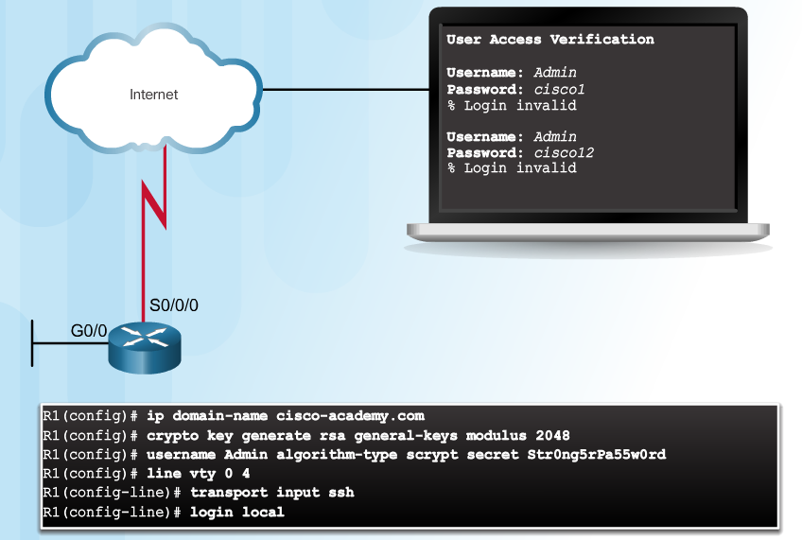
Authentication without AAA (Cont.)
SSH is a more secure form of remote access. It requires both a username and a password, both of which are encrypted during transmissions.
The local database method provides additional security, because an attacker is required to know a username and a password.
It also provides more accountability, because the username is recorded when a user logs in.
Although Telnet can be configured using a username and password, both are sent in plaintext, which makes it vulnerable to being captured and exploited.
SSH and Local Database Method
Notes:
3.1.1.1 Authentication without AAA

Slide 7
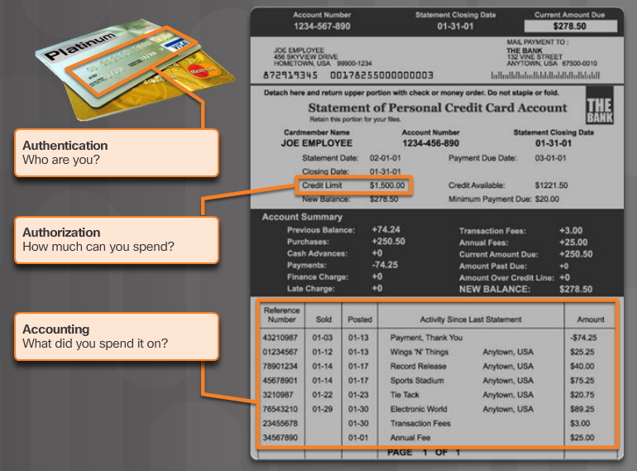
AAA Components
Network and administrative AAA security in the Cisco environment has three functional components:
Notes:
3.1.1.2 AAA Components

Slide 8
Topic 3.1.2: AAA Characteristics

Slide 9
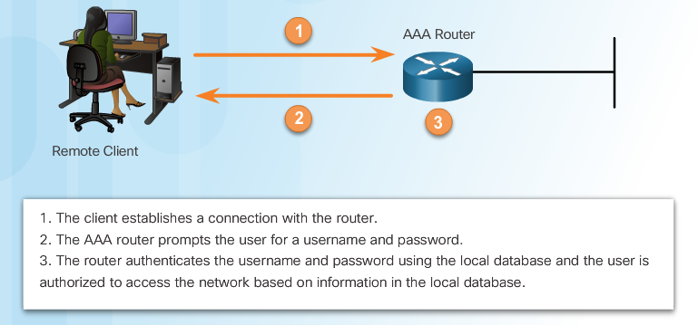
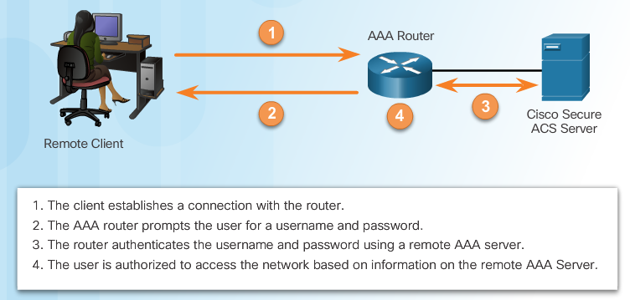
Authentication Modes
Local AAA Authentication
Server-Based AAA Authentication
Notes:
3.1.2.1 Authentication Modes

Slide 10
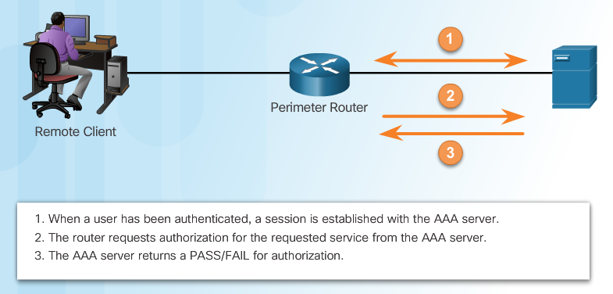
Authorization
AAA Authorization
Notes:
3.1.2.2 Authorization

Slide 11
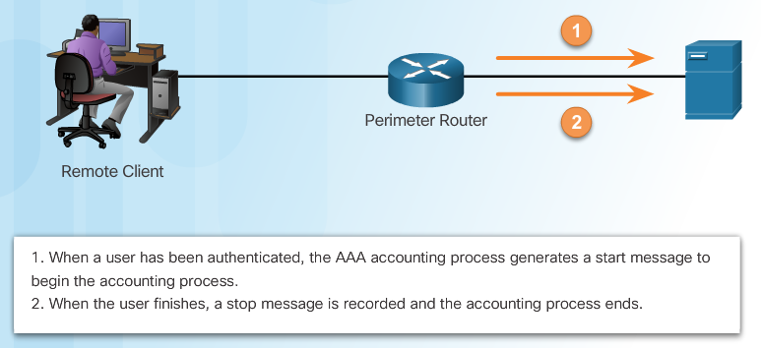
Accounting
AAA Accounting collects and reports usage data. This data can be used for such purposes as auditing or billing. The collected data might include the start and stop connection times, executed commands, number of packets, and number of bytes.
Types of accounting information:
Network
Connection
EXEC
System
Command
Resource
AAA Accounting
Network accounting captures information for all Point-to-Point Protocol (PPP) sessions, including packet and byte counts.
Connection accounting captures information about all outbound connections made from the AAA client, such as Telnet or SSH.
EXEC accounting captures information about user EXEC terminal sessions (user shells) on the network access server, including username, date, start and stop times, and the access server IP address.
System accounting captures information about all system-level events (for example, when the system reboots or when accounting is turned on or off).
Command accounting captures information about the EXEC shell commands for a specified privilege level that are being executed on a network access server. Each command accounting record includes a list of the commands executed for that privilege level, as well as the date and time each command was executed, and the user who executed it.
The Cisco implementation of AAA accounting captures "start" and "stop" record support for calls that have passed user authentication. The additional feature of generating "stop" records for calls that fail to authenticate as part of user authentication is also supported. Such records are necessary for users employing accounting records to manage and monitor their networks.
Notes:
3.1.2.3 Accounting
3.1.2.4 Activity - Indentify the Characteristics of AAA

Slide 12
Section 3.2: Local AAA Authentication
Upon completion of this section, you should be able to:
Configure AAA authentication, using the CLI, to validate users against a local database.
Troubleshoot AAA authentication that validates users against a local database.

Slide 13
Topic 3.2.1: Configuring Local AAA Authentication with CLI

Slide 14
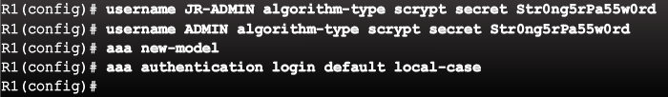
Authenticating Administrative Access
Add usernames and passwords to the local router database for users that need administrative access to the router.
Enable AAA globally on the router.
Configure AAA parameters on the router.
Confirm and troubleshoot the AAA configuration.
Notes:
3.2.1.1 Authenticating Administrative Access

Slide 15
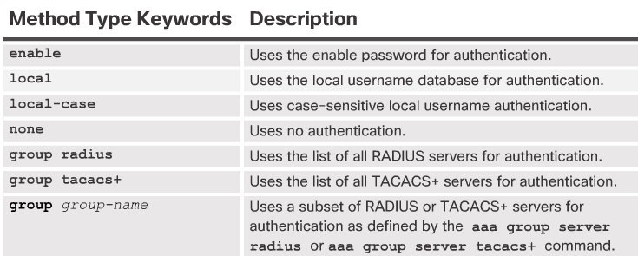
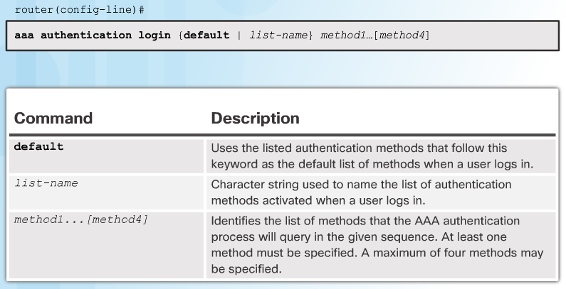
Authentication Methods
Notes:
3.2.1.2 Authentication Methods

Slide 16
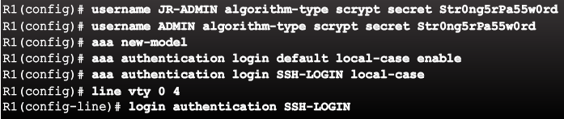
Default and Named Methods
Example Local AAA Authentication
The default keyword means that the authentication method applies to all lines, except those for which a specific line configuration overrides the default.
The authentication is case-sensitive, indicated by the local-case keyword. This means that both the password and the username are case sensitive.
Notes:
3.2.1.3 Default and Named Methods

Slide 17
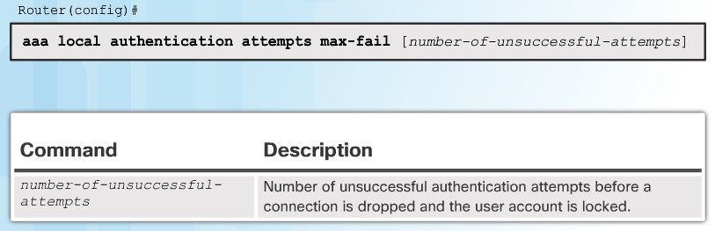

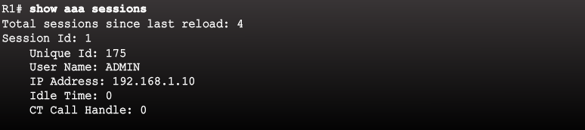
Fine-Tuning the Authentication Configuration
Command Syntax
Display Locked Out Users
Show Unique ID of a Session
Notes:
3.2.1.4 Fine-Tuning the Authentication Configuration

Slide 18
Topic 3.2.2: Troubleshooting Local AAA Authentication

Slide 19
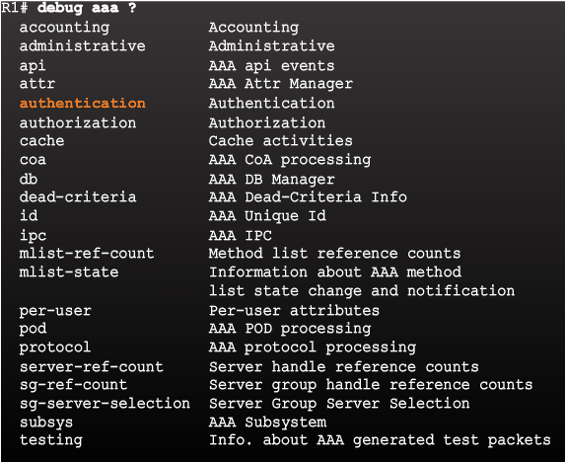
Debug Options
Debug Local AAA Authentication
Notes:
3.2.2.1 Debug Options

Slide 20
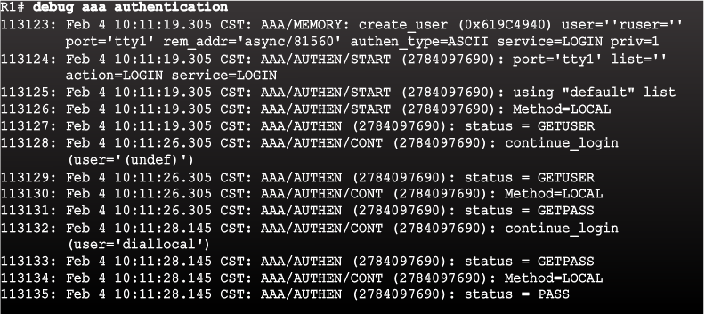
Debugging AAA Authentication
Understanding Debug Output
Notes:
3.2.2.2 Debugging AAA Authentication

Slide 21
Section 3.3: Server-Based AAA
Upon completion of this section, you should be able to:
Describe the benefits of server-based AAA.
Compare the TACACS+ and RADIUS authentication protocols.

Slide 22
Topic 3.3.1: Server-Based AAA Characteristics

Slide 23

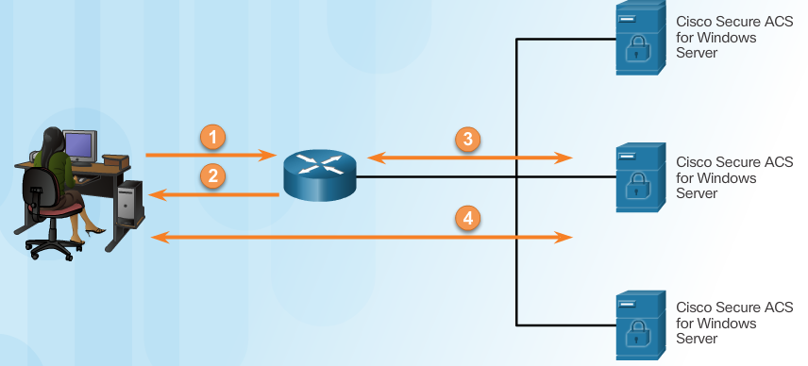
Comparing Local AAA and Server-Based AAA Implementations
Local authentication:
User establishes a connection with the router.
Router prompts the user for a username and password, authentication the user using a local database.
Server-based authentication:
User establishes a connection with the router.
Router prompts the user for a username and password.
Router passes the username and password to the Cisco Secure ACS (server or engine)
The Cisco Secure ACS authenticates the user.
Notes:
3.3.1.1 Comparing Local AAA and Server-Based AAA Implementations

Slide 24
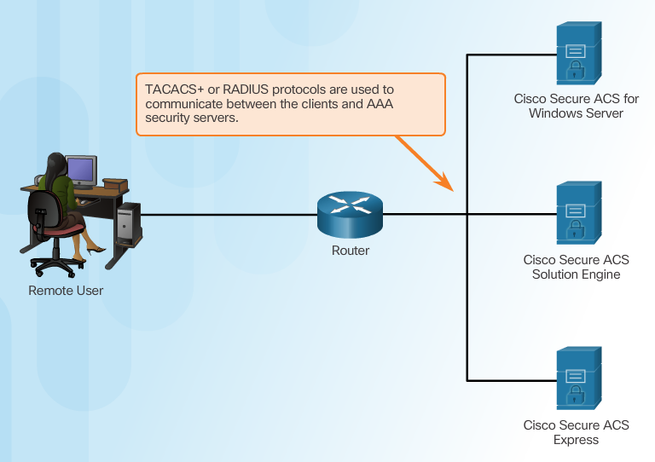
Introducing Cisco Secure Access Control System
Cisco Secure ACS supports both TACACS+ and RADIUS protocols, as shown in the figure. TACACS+ and RADIUS are the two predominant protocols used by Cisco security appliances, routers, and switches for implementing AAA.
Notes:
3.3.1.2 Introducing Cisco Secure Access Control System

Slide 25
Topic 3.3.2: Server-Based AAA Communication Protocols

Slide 26
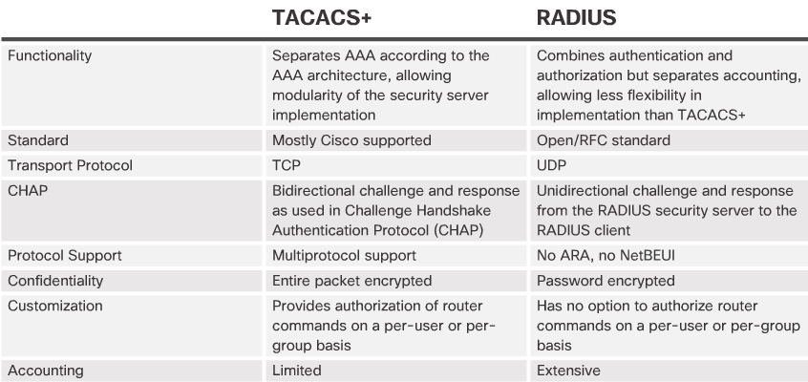
Introducing TACACS+ and RADIUS
ARA – AppleTalk Remote Access.
NetBEUI - NetBIOS Extended User Interface. Is an enhanced version of the NetBios protocol that is used by Microsoft Windows networking. It is a non-routable protocol, which means that computers that are not located on the same network segment or subnet can't communicate.
Notes:
3.3.2.1 Introducing TACACS+ and RADIUS

Slide 27
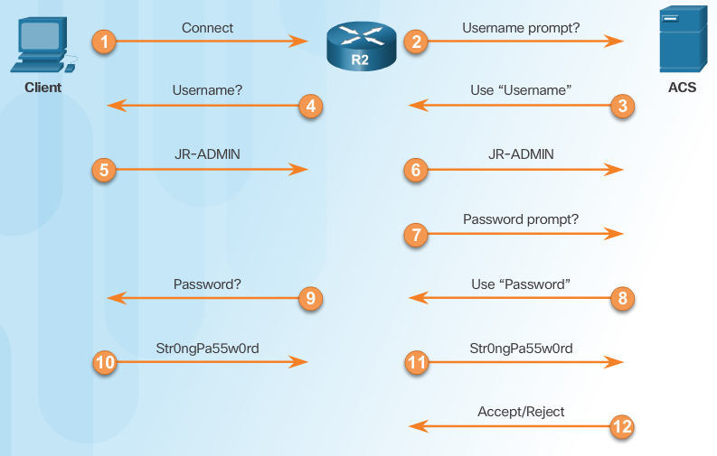
TACACS+ Authentication
TACACS+ Authentication Process
Notes:
3.3.2.2 TACACS+ Authentication

Slide 28
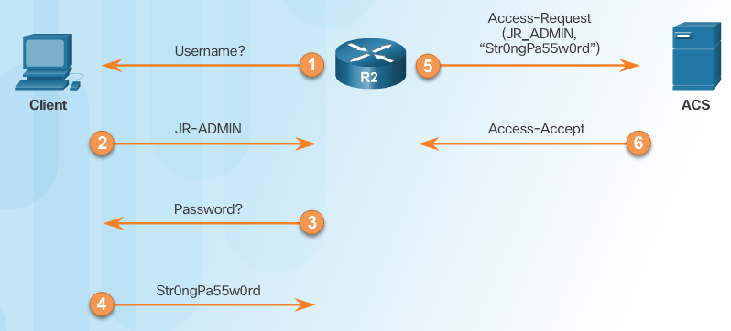
RADIUS Authentication
RADIUS Authentication Process
Notes:
3.3.2.3 RADIUS Authentication

Slide 29
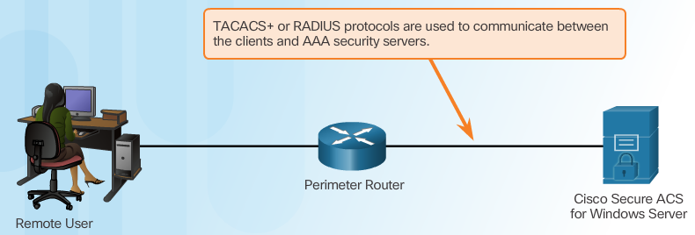
Integration of TACACS+ and ACS
Cisco Secure ACS
Notes:
3.3.2.4 Integration of TACACS+ and ACS

Slide 30
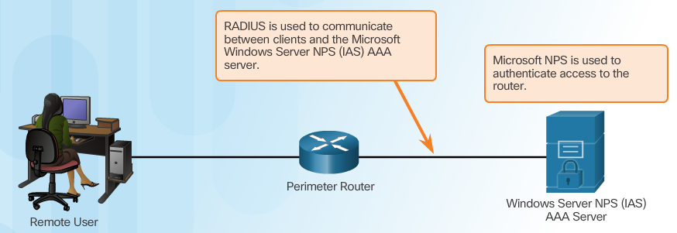
Integration of AAA with Active Directory
Microsoft Active Directory (AD) is a directory service for Windows domain networks, and is part of most Windows Server operating systems. The AD domain controller is used to enforce security policies by authenticating and authorizing users when they log into the Windows domain. Microsoft AD can also be used to handle authentication and authorization on Cisco IOS devices.
Although Cisco Secure ACS can be integrated to use the AD service, Microsoft Windows Server can also be configured as a AAA server. The Microsoft implementation of a AAA server using RADIUS is known as Internet Authentication Service (IAS). However, starting with Windows Server 2008, IAS has since been renamed Network Policy Server (NPS).
Notes:
3.3.2.5 Integration of AAA with Active Directory
3.3.2.6 Video - Integration of AAA with Identity Service Engine
3.3.2.7 Activity - Identify the AAA Communication Protocol

Slide 31
Section 3.4: Server-Based AAA Authentication
Upon completion of this section, you should be able to:
Configure server-based AAA authentication, using the CLI, on Cisco routers.
Troubleshoot server-based AAA authentication.

Slide 32
Topic 3.4.1: Configuring Server-Based Authentication with CLI

Slide 33
Steps for Configuring Server-Based AAA Authentication with CLI
Enable AAA.
Specify the IP address of the ACS server.
Configure the secret key.
Configure authentication to use either the RADIUS or TACACS+ server.
Notes:
3.4.1.1 Steps for Configuring Server-Based AAA Authentication with CLI

Slide 34
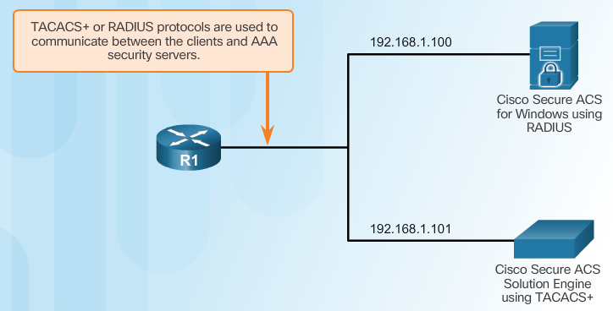
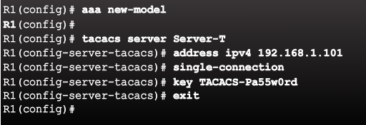
Configuring the CLI with TACACS+ Servers
Server-Based AAA Reference Topology
Use the single-connection command to enhance TCP performance by maintaining a single TCP connection for the life of the session. Otherwise, by default, a TCP connection is opened and closed for each session.
Configure a AAA TACACS+ Server
Notes:
3.4.1.2 Configuring the CLI for TACACS+ Servers

Slide 35
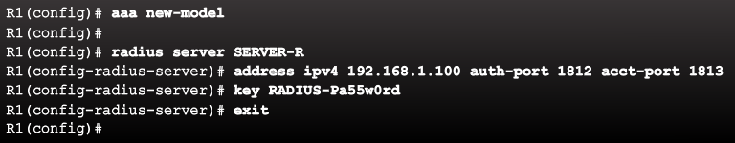
Configuring the CLI for RADIUS Servers
Configure a AAA RADIUS Server
By default, Cisco routers use port 1645 for the authentication and port 1646 for the accounting. However, IANA has reserved ports 1812 for the RADIUS authentication port and 1813 for the RADIUS accounting port. It is important to makes sure these ports match between the Cisco router and the RADIUS server.
Notes:
3.4.1.3 Configuring the CLI for RADIUS Servers

Slide 36
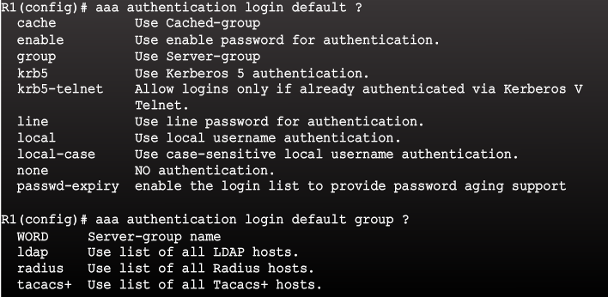
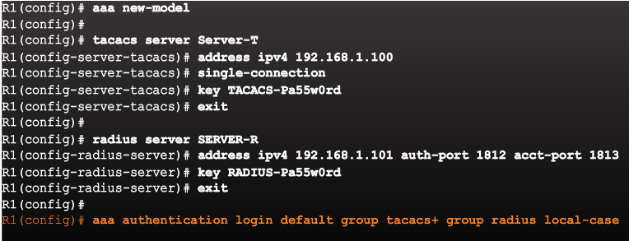
Configure Authentication to Use the AAA Server
Command Syntax
Configure Server-Based AAA Authentication
Notes:
3.4.1.4 Configure Authentication to Use the AAA Server
Syntax Checker - Configure Server-Based AAA Authentication

Slide 37
Topic 3.4.2: Troubleshooting Server-Based AAA Authentication

Slide 38
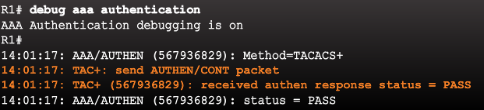
Monitoring Authentication Traffic
Troubleshooting Server-Based AAA Authentication
When AAA is enabled, it is often necessary to monitor authentication traffic and troubleshoot configurations.
The debug aaa authentication command is a useful AAA troubleshooting command because it provides a high-level view of login activity, as shown in the figure.
The command indicates a status message of PASS when a TACACS+ login attempt is successful. If the status message returned is FAIL, verify the secret key and troubleshoot as necessary.
Notes:
3.4.2.1 Monitoring Authentication Traffic

Slide 39
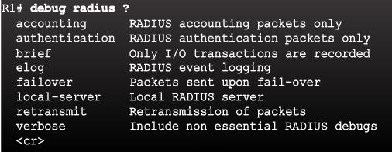
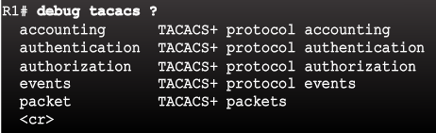
Debugging TACACS+ and RADIUS
Troubleshooting RADIUS
Troubleshooting TACACS+
Notes:
3.4.2.2 Debugging TACACS+ and RADIUS

Slide 40
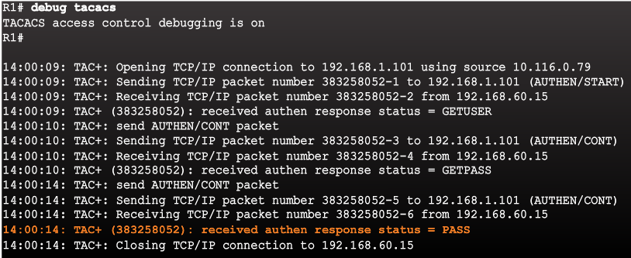
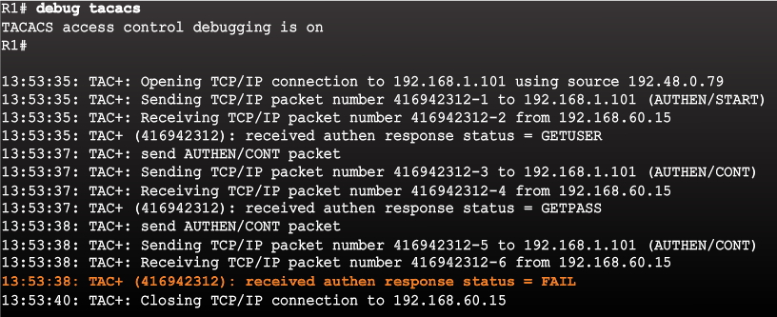
Debugging TACACS+ and RADIUS (Cont.)
AAA Server-Based Authentication Success
AAA Server-Based Authentication Failure
Notes:
3.4.2.2 Debugging TACACS+ and RADIUS (Cont.)
3.4.2.3 Video Demonstration: Configure a Cisco Router to Access a AAA RADIUS Server

Slide 41
Section 3.5: Server-Based AAA Authorization and Accounting
Upon completion of this section, you should be able to:
Configure server-based AAA authorization.
Configure server-based AAA accounting.
Explain the functions of 802.1x components.

Slide 42
Topic 3.5.1: Configuring Server-Based AAA Authorization

Slide 43
Introduction to Server-Based AAA Authorization
Authentication vs. Authorization
Authentication ensures a device or end-user is legitimate
Authorization allows or disallows authenticated users access to certain areas and programs on the network.
TACACS+ vs. RADIUS
TACACS+ separates authentication from authorization
RADIUS does not separate authentication from authorization
Notes:
3.5.1.1 Introduction to Server-Based AAA Authorization

Slide 44
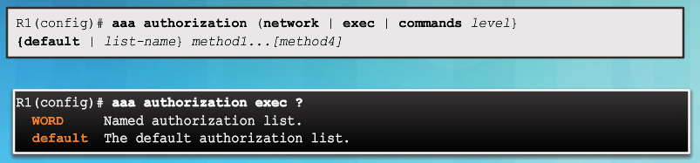
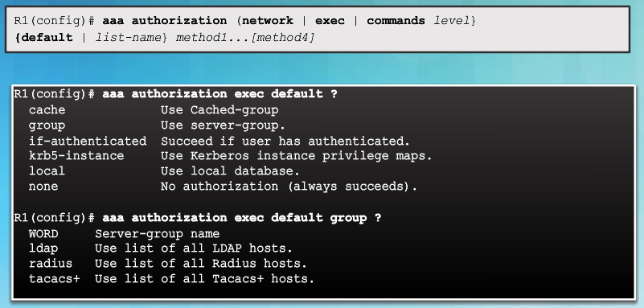
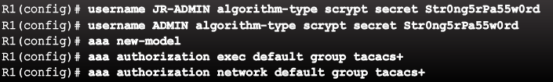
AAA Authorization Configuration with CLI
Command Syntax
Authorization Method Lists
Example AAA Authorization
Notes:
3.5.1.2 AAA Authorization Configuration with CLI

Slide 45
Topic 3.5.2: Configuring Server-Based AAA Accounting

Slide 46

Introduction to Server-Based AAA Accounting
Notes:
3.5.2.1 Introduction to Server-Based AAA Accounting

Slide 47
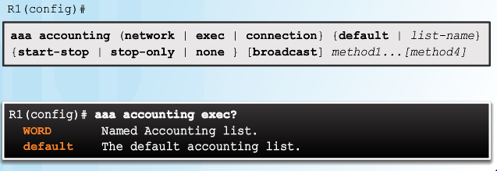
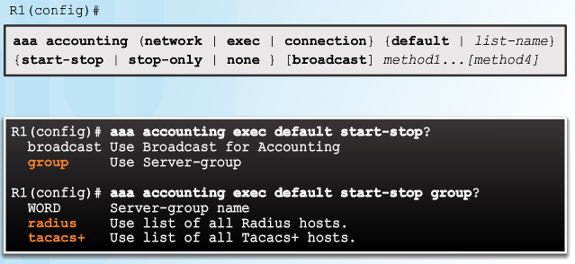
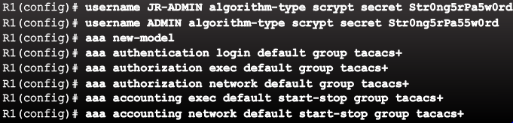
AAA Accounting Configuration with CLI
Command Syntax
Accounting Method Lists
Example AAA Accounting
Notes:
3.5.2.2 AAA Accounting Configuration with CLI
Syntax Checker - Configure AAA Accounting

Slide 48
Topic 3.5.3: 802.1X Authentication

Slide 49
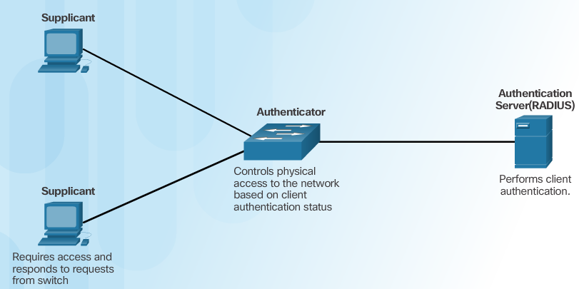
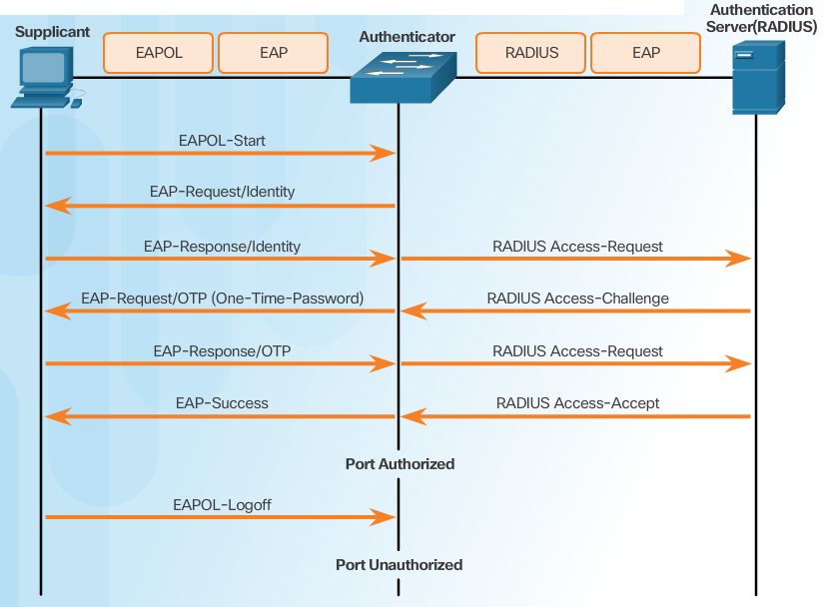
Security Using 802.1X Port-Based Authentication
802.1X Roles
802.1X Message Exchange
Notes:
3.5.3.1 Security Using 802.1X Port-Based Authentication

Slide 50
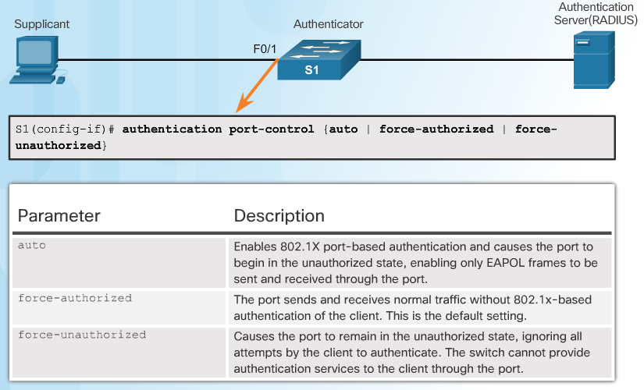
802.1X Port Authorization State
Command Syntax for dot1x port-control
Notes:
3.5.3.2 802.1X Port Authorization State

Slide 51
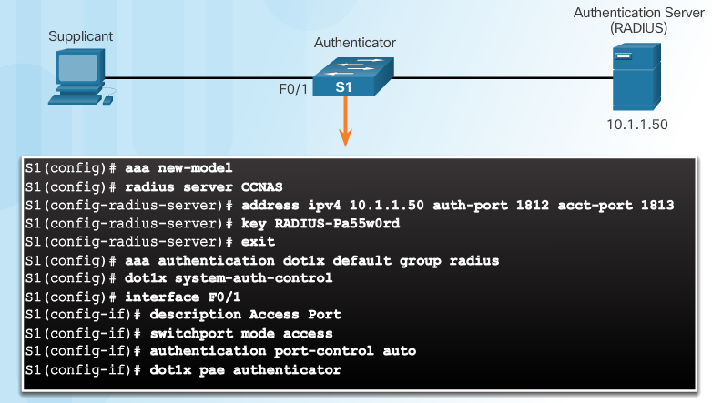
Configuring 802.1X
Notes:
3.5.3.3 Configuring 802.1X
Syntax Checker - Configure 802.1X Port-Authentication on a 2960 Switch
3.6.1.1 Packet Tracer - Configure Authentication on Cisco Routers
3.6.1.2 Lab - Securing Administrative Access Using AAA and RADIUS

Slide 52
Section 3.6: Summary
Chapter Objectives:
Explain how AAA is used to secure a network.
Implement AAA authentication that validates users against a local database.
Implement server-based AAA authentication using TACACS+ and RADIUS protocols.
Configure server-based AAA authorization and accounting.
Notes:
3.6.1.1 Packet Tracer - Configure Authentication on Cisco Routers
3.6.1.2 Lab - Securing Administrative Access Using AAA and RADIUS
3.6.1.3 Summary

Slide 54
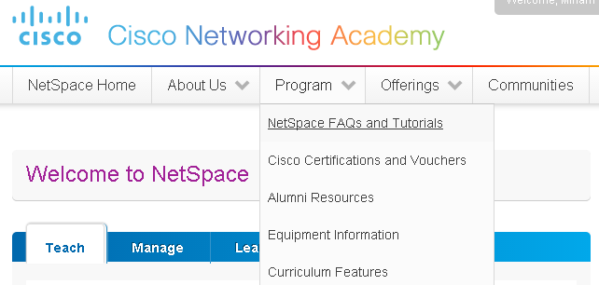
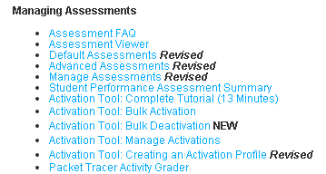
Instructor Resources
Remember, there are helpful tutorials and user guides available via your NetSpace home page. (https://www.netacad.com)
These resources cover a variety of topics including navigation, assessments, and assignments.
A screenshot has been provided here highlighting the tutorials related to activating exams, managing assessments, and creating quizzes.
1
2
Notes:
https://www.netacad.com

